Slide 1

UE23CS320B – Capstone Project Phase – 2
Project Progress Review #2
Project Title : Detecting Depression using vocal cues Project ID : PW26_CBH_04
Project Guide : Ms. Chandravva Hebbi
Project Team : Vishruth Rallapalli, Yuvraj Rao,
Vivan Jeevan Naik, Srujan J

Slide 2
Detecting Depression using vocal cues
Outline
Abstract and scope.
Suggestions from phase 2 review 1
Design Approach.
Design constraints, Assumptions and Dependencies
Clinical Validity of Acoustic & Prosodic Features
Proposed methodology/Approach
Architecture
System Architecture & Data Pipeline
Implementation Highlights
Design Description
Technology used
Dataset Exploration
Data Pre-processing
Extracted Features
Graph & Output Interpretation
Temporal Modeling Plan
Explainability & Output Interpretation
Method-1 vs Method-2: Strategy Comparison
References
Any other Information

Slide 3
Detecting Depression using vocal cues
Abstract and Scope
Problem Statement: Detecting depression effectively using vocal cues from speech recordings.
Introduction: Our system converts raw voice input into meaningful mental health predictions. We have engineered a custom, end-to-end data pipeline that ingests raw clinical interviews, isolates relevant participant speech via transcript parsing, and extracts temporal acoustic biomarkers.
Scope: The system acts as a scalable, device-independent primary screening tool, transforming massive raw audio files into structured, frame-by-frame feature datasets optimized for sequential deep learning.

Slide 4
Detecting Depression using vocal cues
Suggestions from Phase2 review 1
Feedback 1: Clinical Validity of Features:
Suggestion: Provide medical/academic proof that the emphasized prosodic and acoustic features (like MFCCs) are valid indicators of depression.
Action Taken: We have grounded our feature selection in established clinical research (referenced in our Literature Review). Features like flattened F0 and reduced dynamic energy are proven biomarkers for psychomotor retardation associated with depression.
Feedback 2: Enhanced Graph Interpretability
Suggestion: Provide a more detailed explanation of the output graphs and what they signify.
Action Taken: We have integrated an Attention Mechanism into our LSTM model. We will showcase detailed Attention Heatmaps and Waveform Overlays to visually explain exactly which speech segments the model flags.

Slide 5
Detecting Depression using vocal cues
Design Approach
Approach Followed: A modular, dual-processing pipeline utilizing customized, code-driven audio cleaning paired with robust feature extraction libraries.
Key Differentiator: Unlike standard approaches, our system integrates transcript-based speaker isolation with frame-level feature extraction for significantly improved signal quality.
Benefits: By filtering out interviewer noise and extracting features at the micro-frame level, we provide our downstream temporal models (LSTM) with highly concentrated, patient-specific behavioral data.

Slide 6
Detecting Depression using vocal cues
Design Constraints, Assumptions & Dependencies
Constraints: Demographic variance (e.g., male vs. female vocal baselines) requires careful thresholding to avoid biased sensitivity.
Assumptions: Short-duration, frame-level speech segments contain sufficient paralinguistic biomarkers for accurate detection.
Dependencies: Python-based signal processing libraries (librosa, scipy, numpy, pandas) to handle the heavy lifting of audio manipulation and feature structuring.

Slide 7
Detecting Depression using vocal cues
Clinical Validity of Acoustic & Prosodic Features
Prosodic Features (F0/Pitch & Energy): Depressed individuals frequently exhibit psychomotor retardation, leading to flattened intonation, reduced volume, and slower speech rates.
Medical Backing: Cummins et al. (2015) and Williamson et al. (2014) demonstrate that motor incoordination directly alters these prosodic vocal biomarkers.
Acoustic/Spectral Features (MFCCs): Mel-Frequency Cepstral Coefficients (MFCCs) capture the shape of the vocal tract. Depression alters muscle tension and articulation, changing the timbre of the voice.
Medical Backing: Alghowinem et al. (2013) validated that MFCC variance is a highly reliable metric for distinguishing depressed speech from healthy spontaneous speech.

Slide 8
Detecting Depression using vocal cues
Proposed Methodology / Approach
Enhanced Pipeline Flow:
Transcript-driven speaker filtering: Automated removal of the virtual interviewer (Ellie).
  Modular preprocessing pipeline: Sequential application of Noise Reduction, Silence Removal, and Normalization (preprocess_audio(segment, sr)).
  Frame-wise segmentation: Dynamic slicing of continuous speech into discrete chunks.
  Feature extraction: Granular extraction of MFCC, Energy, and Pitch per frame.

Slide 9
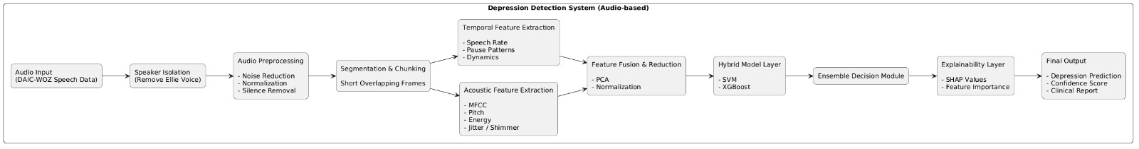
Detecting Depression using vocal cues
Architecture
High-Level Design View: Raw Speech Input (300_AUDIO.wav + 300_TRANSCRIPT.csv) -> Intelligent Speaker Isolation -> Segmentation and Framing -> Feature Extraction (Librosa) -> Structured Output (frame_features.csv) -> Temporal Consistency Modeling -> Prediction.

Slide 10
Detecting Depression using vocal cues
System Architecture & Data Pipeline
Step 1: Multi-Modal Input: Ingestion of raw audio (300_AUDIO.wav) alongside its corresponding transcript (300_TRANSCRIPT.csv).
Step 2: Intelligent Speaker Isolation: Automated parsing of the CSV to strip out the virtual interviewer ("Ellie") and isolate purely participant speech.
Step 3: Signal Preprocessing: Applying noise reduction, silence trimming, and RMS normalization to the isolated audio.
Step 4: Micro-Segmentation: Dynamic slicing of continuous speech into discrete, sequential frames suitable for recurrent neural networks.
Step 5: Feature Extraction: Generating the final 28-dimensional feature sets (MFCCs, Pitch, Energy) and outputting to structured CSVs.

Slide 11
Detecting Depression using vocal cues
Implementation Highlights
Key Engineering Contributions:
Automated transcript parsing for speaker isolation: The system reads the CSV, maps timestamps, and completely discards interviewer speech (if speaker != "participant": continue), ensuring the model learns only from the patient.
Dynamic frame generation: The framing script automatically converts cleaned speech into thousands of usable micro-segments (e.g., segX_frameY.wav), perfectly formatted for LSTM input.
Optimized Feature Extraction: Utilizing highly specific parameters like n_fft=512 for precise frequency resolution.
Scalable pipeline architecture: The code is designed for large-scale dataset processing, intelligently skipping already processed data to save compute time.

Slide 12
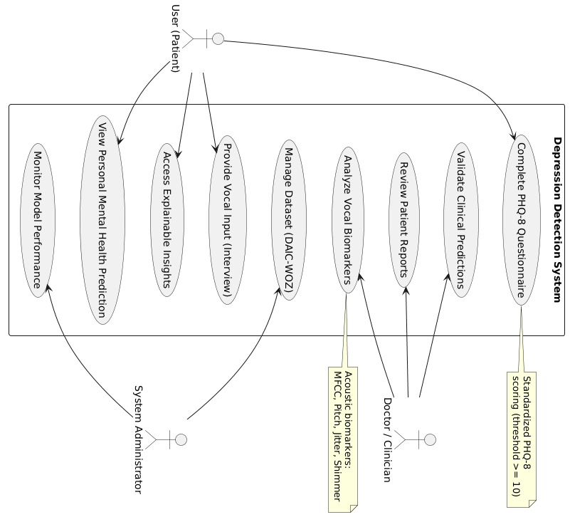
Detecting Depression using vocal cues
Design Description
Use case Diagram

Slide 13
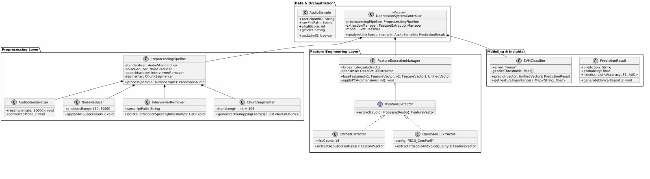
Detecting Depression using vocal cues
Design Description
Master class Diagram

Slide 14
Detecting Depression using vocal cues
Technologies Used
librosa & scipy: The core engines for our custom audio loading, filtering, framing, and granular feature extraction (Pitch tracking, MFCCs).
pandas & numpy: For parsing transcript CSVs, numerical matrix operations on audio arrays, and structuring the final 28-dimensional feature sets.
noisereduce: Background noise suppression before feature extraction.

Slide 15
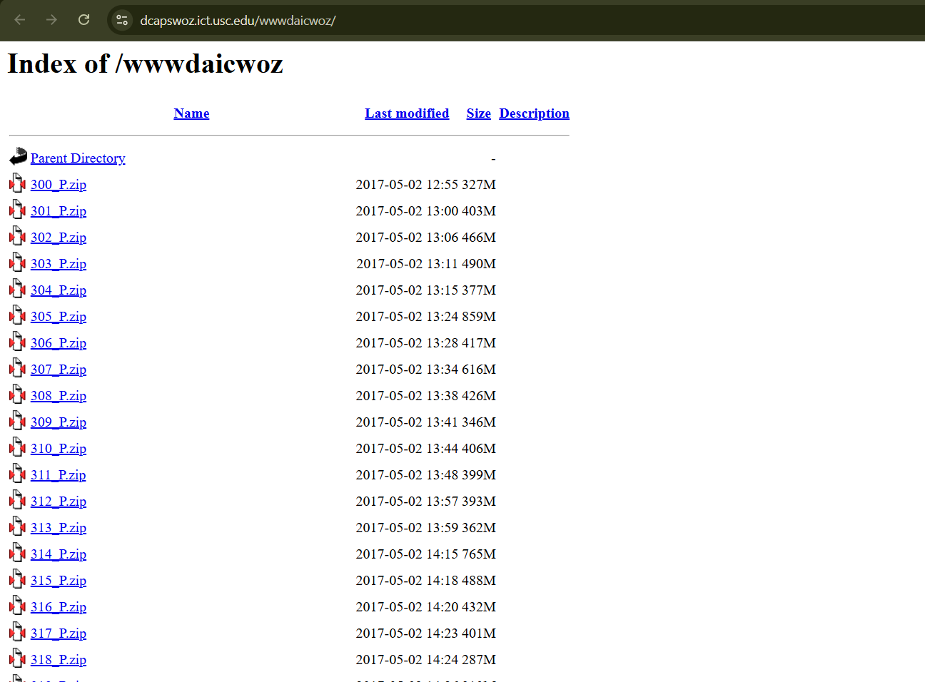
Detecting Depression using vocal cues
Data Exploration
Dataset Used: DAIC-WOZ (AVEC Standard Dataset).
Current Processing Milestone: We have successfully processed initial subject data (e.g., Participant 300). By mapping the raw audio against the transcript, we proved our automated isolation logic works reliably at scale.

Slide 16
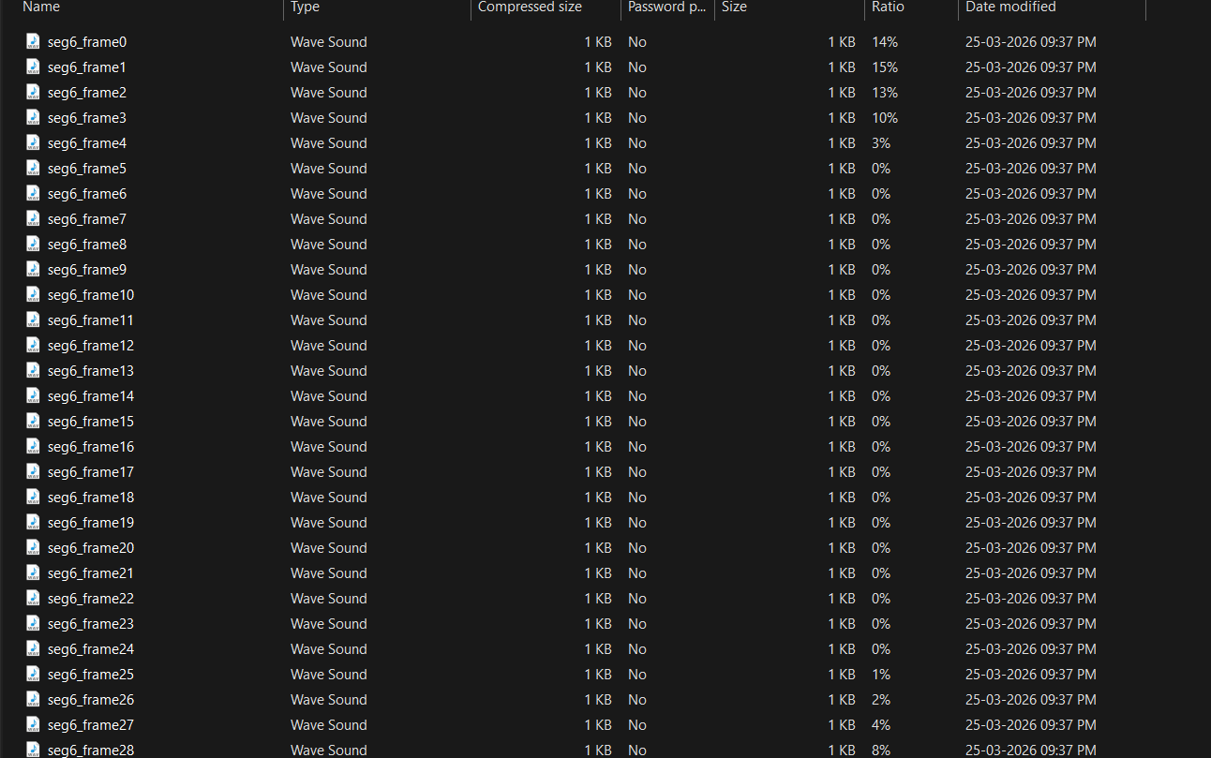
Detecting Depression using vocal cues
Data Preprocessing
Current Milestones Achieved:
Speaker-level filtering implemented: Interviewer artifacts are successfully removed from the training data.
Frame-wise dataset generation: The pipeline successfully cuts and saves thousands of dynamic .wav frames per session.
Feature extraction pipeline optimized: The system is now capable of handling large-scale data processing efficiently.

Slide 17
Detecting Depression using vocal cues
Extracted Features (The Core ML Input)
Our custom extraction function (librosa) captures 28 precise data points per audio frame:
MFCCs: 13 mean values + 13 standard deviation values = 26 features.
Energy: Root Mean Square (RMS) energy calculation = 1 feature.
Pitch: librosa.piptrack analysis = 1 feature
Total: 28 features per frame.
Critical Takeaway: Features are extracted per frame, enabling advanced temporal modeling using LSTM.
Feature | Dim | Captures
MFCC | 16 | Vocal tract shape & timbre
Δ MFCC | 16 | Speech dynamics & articulation
Loudness | 1 | Energy & intensity

Slide 18
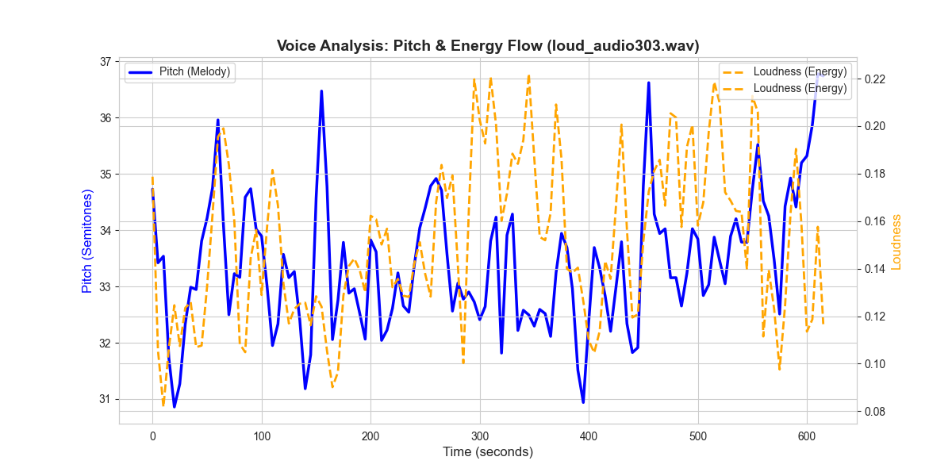
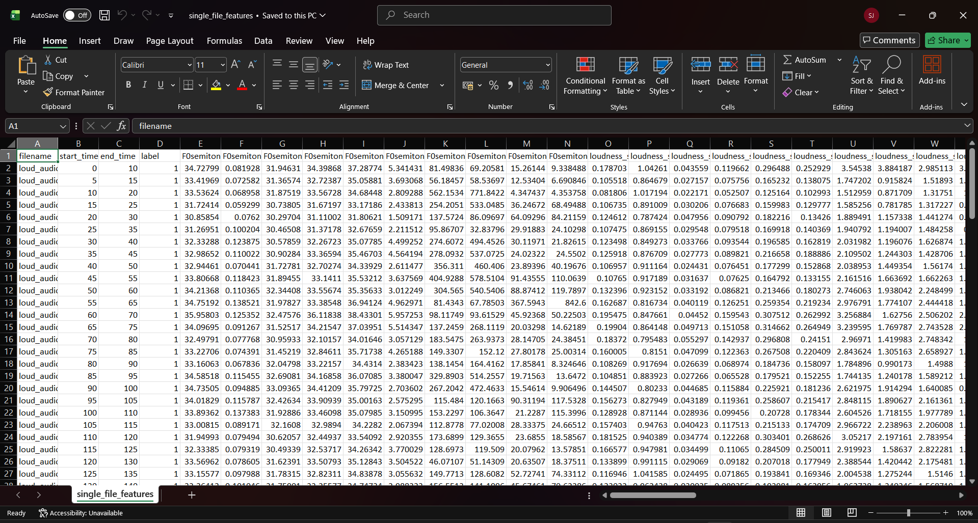
Detecting Depression using vocal cues
Graph & Output Interpretation
The graph shows segment-wise acoustic behavior of the speaker.
Reduced pitch and loudness variability, along with stable MFCC patterns, indicate flattened prosody and reduced expressiveness, which are commonly associated with depressive speech.
The CSV contains numerical acoustic feature values per speech segment, where:
Rows correspond to individual audio segments
Columns represent extracted prosodic, spectral, voice-quality, and temporal features. These values act as input features for machine learning models, not final diagnosis scores.

Slide 19
Detecting Depression using vocal cues
Temporal Modeling Plan
LSTM + Attention Mechanism: Our architecture uses LSTM to track the sequential frame_features.csv data over time.
Why Attention? It allows the model to learn long-range dependencies and focus on emotionally salient moments (like pauses or flat prosody) rather than treating all 12,000+ speech segments from a session equally.

Slide 20
Detecting Depression using vocal cues
Explainability & Output Interpretation
Clinical Interpretability: The system will output Attention Heatmaps over time.
Visualization: High attention weights will highlight important time regions, often aligning with low or irregular vocal energy (known depressive markers). This ensures our tool acts as a transparent decision-support system, not a "black box."

Slide 21
Detecting Depression using vocal cues
Method-1 vs Method-2: Strategy Comparison
Standard Approach vs. Our Proposed Pipeline:
Audio Cleaning: Basic resampling vs. Transcript-driven speaker isolation + SNR suppression.
Data Structure: Session-level statistics vs. Dynamic micro-frame generation (segX_frameY).
Feature Engineering: Out-of-the-box bulk extraction vs. Targeted 28-feature extraction optimized for sequential learning.

Slide 22
Detecting Depression using vocal cues
References
Alghowinem, S., et al. (2013) ‘Detecting depression: A comparison between spontaneous and read speech’, IEEE ICASSP.
Cummins, N., et al. (2015) ‘A review of depression and suicide risk assessment using speech analysis’, Speech Communication.
Morales, M.R.A., et al. (2018) ‘Speech vs. text: A comparative analysis of features for depression detection systems’, IEEE SLT.
Williamson, J.R., et al. (2014) ‘Vocal biomarkers of depression based on motor incoordination’, ACM Multimedia.

Slide 23
Thank You

